Slide 1
First Destination Survey
Key Data for Advancing Outcomes
Institutional Research & Decision Support
VCU Career Services
Spring 2019

Slide 2
What Data Do We Collect?
Primary Outcomes: Employment, Further Education, Seeking Status
Employment includes internships, fellowships, volunteering, military
Organization, title, and industry information
Location
Salary (if applicable)
Engagement in internships, service learning, and other experiential learning
Non-VCU email address for future contact
Relation of career outcomes to academic pursuits and goals

Slide 3
Why Collect Outcomes Data?
Provide accurate information on graduate outcomes (undergrad, graduate, and professional) to and for:
Prospective Students, Parents, and Families
Current students making major and career choices
Academic departments reviewing curriculum and considering programs
Alumni Relations and individual alumni looking to connect and contribute
University Relations and communications for branding and marketing
Faculty and staff advisors working directly with students at all levels

Slide 4
Why Collect Outcomes Data?
Leverage data for institutional initiatives
Admissions
Donor and Alumni Relations
Orientation
Advising
Research

Slide 5
History of the VCU Outcomes Survey
Response Rates
Involved Offices and Professionals
Communications and Marketing Efforts
Reporting and Sharing Data
Notes:
Before the VCU Outcomes Survey the survey was administered by GradLeaders as the First Destination Survey
VCU participated as pilot along with just a few other institutions
Response Rate at that time was down to 19%
Well over 100 questions including branching
A small group of stakeholders across campus was pulled together to streamline the survey down and the survey was administered in-house by SERL
These offices were from:
Career Services, Engineering, Business, Alumni, Wilder School, Allied Health and Professions
Communications and Marketing Efforts
Advisors assisted
Flyers
Emails
GradFair
Reporting and Sharing Data
Collected knowledge rate from some schools
Overall Report for May 2017 class on IR&DS website

Slide 6
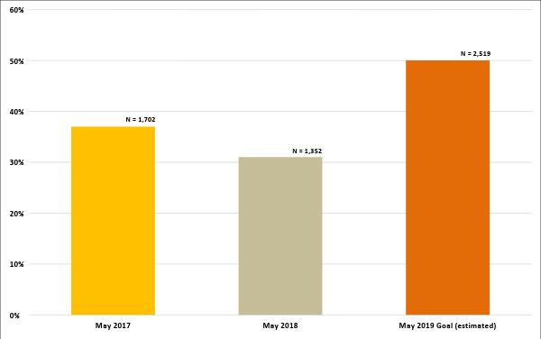
VCU Outcomes Survey Overall Response Rates

Slide 7
Plans & Progress for 2019
Collaborative Effort between IRDS & Career Services
Benchmarking for Best Practices
Utilizing In-House, Familiar Technology (Handshake)
Increase Response Rate and Knowledge Rate by:
Connecting with graduation requirements and commencement events
Designing and deploying a strategic marketing campaign
Engaging with and relying on Campus Partners for a streamlined and supported approach
Offering incentives for student participants at graduation and at 6-month mark

Slide 8
We Need Your Help!
This data helps us all, and we need your support for maximum impact
Encouraging participation, dispelling myths
Timeline:
Initial survey distribution: April 18
First incentive deadline: May 3
Second incentive deadline: May 15
First snapshot and call for Knowledge Rate information: June 3
Final incentive deadline + survey closes: November 11
Goal of 50% Response Rate + 15% Additional Knowledge Rate (65% total): December 2019

Slide 9
Thank you!
Contact us for further information
Samara Reynolds, Director of Career Services, sreynolds4@vcu.edu
Constance Peyton, Manager Institutional Research, cwpeyton@vcu.edu
Monal Patel, Associate Vice Provost Institutional Research & Decision Support, mpatel22@vcu.edu

